Slide 1
Chapter 4
Further issues with
the classical linear regression model
‘Introductory Econometrics for Finance’ © Chris Brooks 2002

Slide 2


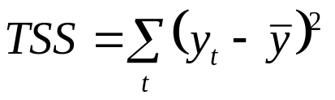
Goodness of Fit Statistics
We would like some measure of how well our regression model actually fits the data.
We have goodness of fit statistics to test this: i.e. how well the sample regression function (srf) fits the data.
The most common goodness of fit statistic is known as R². One way to define R² is to say that it is the square of the correlation coefficient between y and .
For another explanation, recall that what we are interested in doing is explaining the variability of y about its mean value, , i.e. the total sum of squares, TSS:
We can split the TSS into two parts, the part which we have explained (known as the explained sum of squares, ESS) and the part which we did not explain using the model (the RSS).
‘Introductory Econometrics for Finance’ © Chris Brooks 2002

Slide 3
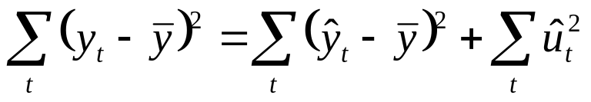
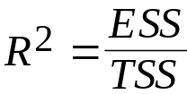
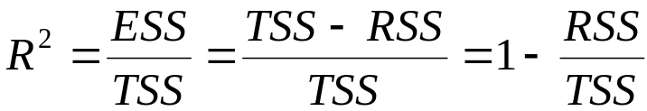
Defining R²
That is, TSS = ESS + RSS
Our goodness of fit statistic is
But since TSS = ESS + RSS, we can also write
R² must always lie between zero and one. To understand this, consider two extremes
RSS = TSS i.e. ESS = 0 so R² = ESS/TSS = 0
ESS = TSS i.e. RSS = 0 so R² = ESS/TSS = 1
‘Introductory Econometrics for Finance’ © Chris Brooks 2002

Slide 4
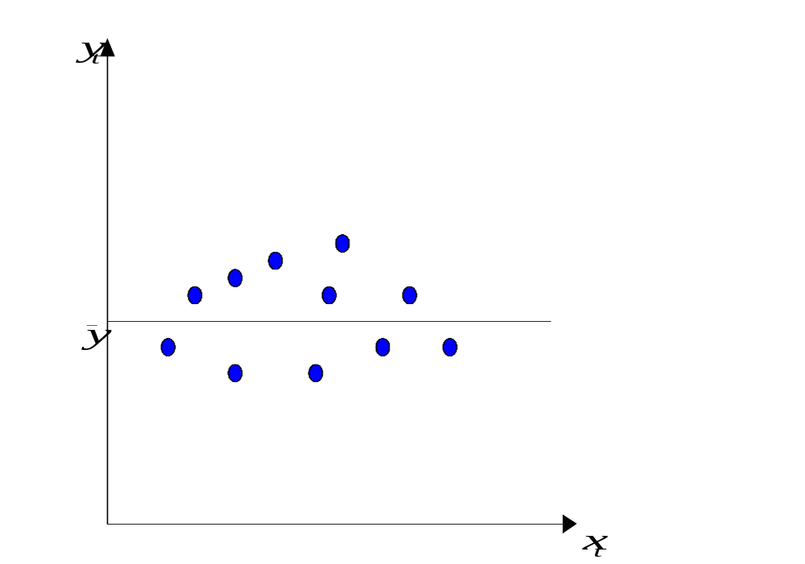
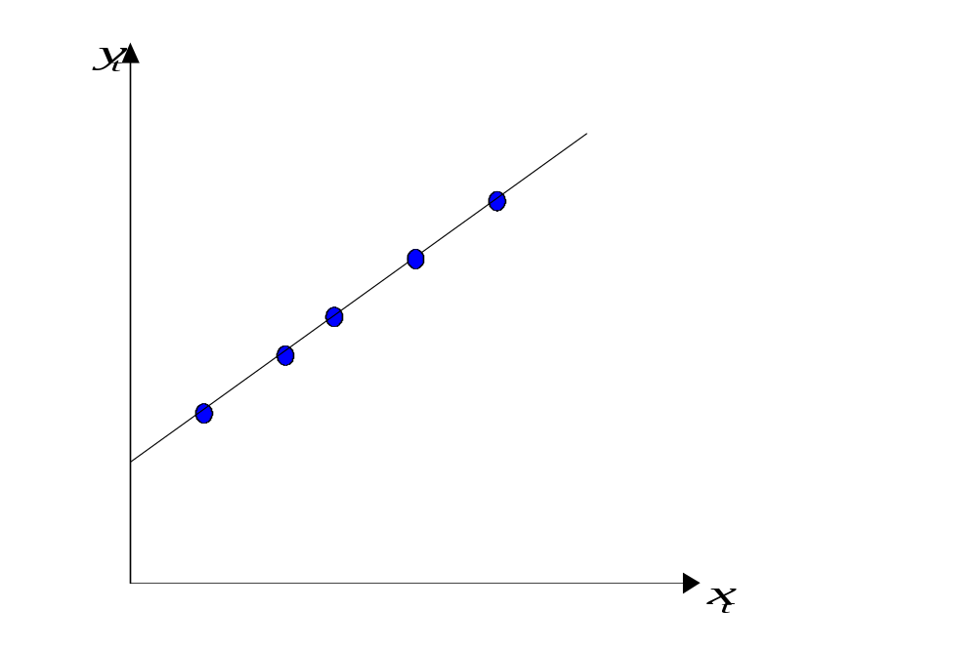
The Limit Cases: R² = 0 and R² = 1
‘Introductory Econometrics for Finance’ © Chris Brooks 2002

Slide 5
Problems with R² as a Goodness of Fit Measure
There are a number of them:
1. R² is defined in terms of variation about the mean of y so that if a model is reparameterised (rearranged) and the dependent variable changes, R² will change.
2. R² never falls if more regressors are added. to the regression, e.g. consider:
Regression 1: y_{t} = β₁ + β₂x_{2t} + β₃x_{3t} + u_{t}
Regression 2: y = β₁ + β₂x_{2t} + β₃x_{3t} + β₄x_{4t} + u_{t}
R² will always be at least as high for regression 2 relative to regression 1.
3. R² quite often takes on values of 0.9 or higher for time series regressions.
‘Introductory Econometrics for Finance’ © Chris Brooks 2002

Slide 6

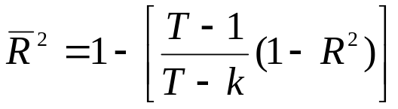
Adjusted R²
In order to get around these problems, a modification is often made which takes into account the loss of degrees of freedom associated with adding extra variables. This is known as , or adjusted R^{2:}
So if we add an extra regressor, k increases and unless R² increases by a more than offsetting amount, will actually fall.
There are still problems with the criterion:
1. A “soft” rule
    2. No distribution for or R²
‘Introductory Econometrics for Finance’ © Chris Brooks 2002

Slide 7
A Regression Example:
Hedonic House Pricing Models
Hedonic models are used to value real assets, especially housing, and view the asset as representing a bundle of characteristics.
Des Rosiers and Thérialt (1996) consider the effect of various amenities on rental values for buildings and apartments 5 sub-markets in the Quebec area of Canada.
The rental value in Canadian Dollars per month (the dependent variable) is a function of 9 to 14 variables (depending on the area under consideration). The paper employs 1990 data, and for the Quebec City region, there are 13,378 observations, and the 12 explanatory variables are:
LnAGE - log of the apparent age of the property
NBROOMS - number of bedrooms
AREABYRM - area per room (in square metres)
ELEVATOR - a dummy variable = 1 if the building has an elevator; 0 otherwise
BASEMENT - a dummy variable = 1 if the unit is located in a basement; 0 otherwise
‘Introductory Econometrics for Finance’ © Chris Brooks 2002

Slide 8
Hedonic House Pricing Models:
Variable Definitions
OUTPARK - number of outdoor parking spaces
INDPARK - number of indoor parking spaces
NOLEASE - a dummy variable = 1 if the unit has no lease attached to it; 0 otherwise
LnDISTCBD - log of the distance in kilometres to the central business district
SINGLPAR - percentage of single parent families in the area where the building stands
DSHOPCNTR- distance in kilometres to the nearest shopping centre
VACDIFF1 - vacancy difference between the building and the census figure
Examine the signs and sizes of the coefficients.
  The coefficient estimates themselves show the Canadian dollar rental price per month of each feature of the dwelling.
‘Introductory Econometrics for Finance’ © Chris Brooks 2002

Slide 9
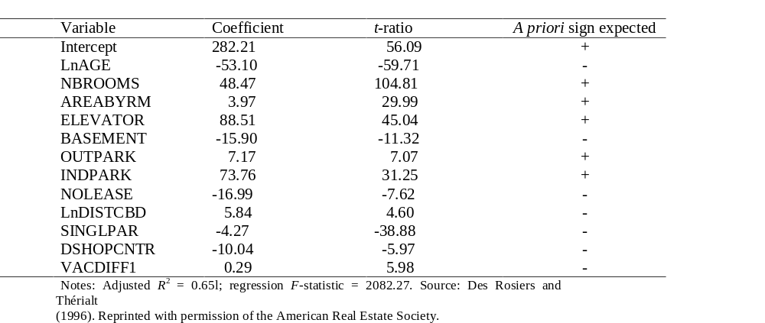
Hedonic House Price Results
Dependent Variable: Canadian Dollars per Month
‘Introductory Econometrics for Finance’ © Chris Brooks 2002

Slide 10
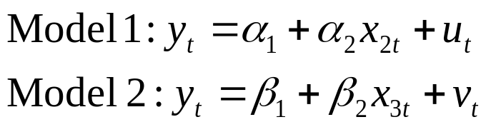

Tests of Non-nested Hypotheses
All of the hypothesis tests concluded thus far have been in the context of “nested” models.
But what if we wanted to compare between the following models?
We could use R² or adjusted R², but what if the number of explanatory variables were different across the 2 models?
An alternative approach is an encompassing test, based on examination of the hybrid model:
‘Introductory Econometrics for Finance’ © Chris Brooks 2002

Slide 11
Tests of Non-nested Hypotheses (cont’d)
There are 4 possible outcomes when Model 3 is estimated:
  γ₂ is significant but γ₃ is not
  γ₃ is significant but γ₂ is not
  γ₂ and γ₃ are both statistically significant
  Neither γ₂ nor γ₃ are significant
Problems with encompassing approach
  Hybrid model may be meaningless
  Possible high correlation between x₂ and x₃.
‘Introductory Econometrics for Finance’ © Chris Brooks 2002

Slide 12
Violation of the Assumptions of the CLRM
Recall that we assumed of the CLRM disturbance terms:
1. E(u_{t}) = 0
2. Var(u_{t}) = σ² < ∞
3. Cov (u_{i},u_{j}) = 0
4. The X matrix is non-stochastic or fixed in repeated samples
5. u_{t} ∼ N(0,σ²)
‘Introductory Econometrics for Finance’ © Chris Brooks 2002

Slide 13
Investigating Violations of the
Assumptions of the CLRM
We will now study these assumptions further, and in particular look at:
- How we test for violations
- Causes
- Consequences
in general we could encounter any combination of 3 problems:
- the coefficient estimates are wrong
- the associated standard errors are wrong
- the distribution that we assumed for the
test statistics will be inappropriate
- Solutions
- the assumptions are no longer violated
- we work around the problem so that we
use alternative techniques which are still valid
‘Introductory Econometrics for Finance’ © Chris Brooks 2002

Slide 14
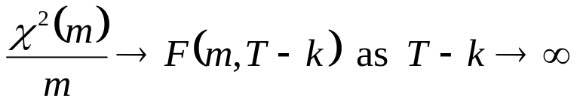
Statistical Distributions for Diagnostic Tests
Often, an F- and a χ²- version of the test are available.
The F-test version involves estimating a restricted and an unrestricted version of a test regression and comparing the RSS.
The χ²- version is sometimes called an “LM” test, and only has one degree of freedom parameter: the number of restrictions being tested, m.
Asymptotically, the 2 tests are equivalent since the χ² is a special case of the F-distribution:
For small samples, the F-version is preferable.
‘Introductory Econometrics for Finance’ © Chris Brooks 2002

Slide 15
Assumption 1: E(u_{t}) = 0
Assumption that the mean of the disturbances is zero.
For all diagnostic tests, we cannot observe the disturbances and so perform the tests of the residuals.
The mean of the residuals will always be zero provided that there is a constant term in the regression.
‘Introductory Econometrics for Finance’ © Chris Brooks 2002

Slide 16
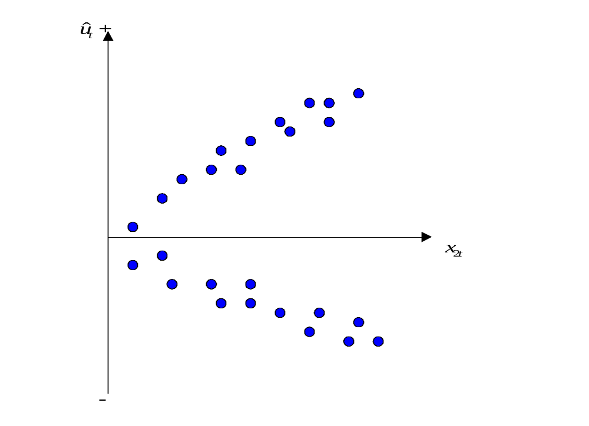

Assumption 2: Var(u_{t}) = σ² < ∞
We have so far assumed that the variance of the errors is constant, σ² - this is known as homoscedasticity. If the errors do not have a constant variance, we say that they are heteroscedastic e.g. say we estimate a regression and calculate the residuals, .
‘Introductory Econometrics for Finance’ © Chris Brooks 2002

Slide 17
Detection of Heteroscedasticity
Graphical methods
Formal tests:
One of the best is White’s general test for heteroscedasticity.
The test is carried out as follows:
1. Assume that the regression we carried out is as follows
y_{t} = β₁ + β₂x_{2t} + β₃x_{3t} + u_{t}
And we want to test Var(u_{t}) = σ². We estimate the model, obtaining the residuals,
2. Then run the auxiliary regression
‘Introductory Econometrics for Finance’ © Chris Brooks 2002

Slide 18
Performing White’s Test for Heteroscedasticity
3. Obtain R² from the auxiliary regression and multiply it by the number of observations, T. It can be shown that
T R² ∼ χ² (m)
where m is the number of regressors in the auxiliary regression excluding the constant term.
4. If the χ² test statistic from step 3 is greater than the corresponding value from the statistical table then reject the null hypothesis that the disturbances are homoscedastic.
‘Introductory Econometrics for Finance’ © Chris Brooks 2002

Slide 19
Consequences of Using OLS in the Presence of Heteroscedasticity
OLS estimation still gives unbiased coefficient estimates, but they are no longer BLUE.
This implies that if we still use OLS in the presence of heteroscedasticity, our standard errors could be inappropriate and hence any inferences we make could be misleading.
Whether the standard errors calculated using the usual formulae are too big or too small will depend upon the form of the heteroscedasticity.
‘Introductory Econometrics for Finance’ © Chris Brooks 2002

Slide 20

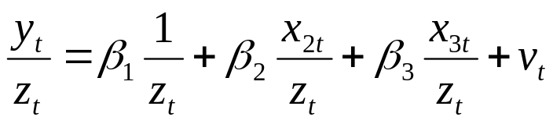
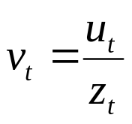
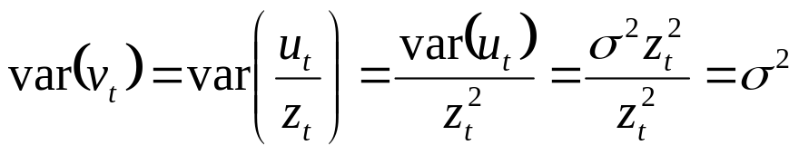
How Do we Deal with Heteroscedasticity?
If the form (i.e. the cause) of the heteroscedasticity is known, then we can use an estimation method which takes this into account (called generalised least squares, GLS).
A simple illustration of GLS is as follows: Suppose that the error variance is related to another variable z_{t} by
To remove the heteroscedasticity, divide the regression equation by z_{t}
where is an error term.
Now for known z_{t}.
‘Introductory Econometrics for Finance’ © Chris Brooks 2002

Slide 21
Other Approaches to Dealing with Heteroscedasticity
So the disturbances from the new regression equation will be homoscedastic.
Other solutions include:
1. Transforming the variables into logs or reducing by some other measure of “size”.
2. Use White’s heteroscedasticity consistent standard error estimates.
The effect of using White’s correction is that in general the standard errors for the slope coefficients are increased relative to the usual OLS standard errors.
This makes us more “conservative” in hypothesis testing, so that we would need more evidence against the null hypothesis before we would reject it.
‘Introductory Econometrics for Finance’ © Chris Brooks 2002

Slide 22
Background –
The Concept of a Lagged Value
t y_{t} y_{t-1} Δy_{t}
1989M09 0.8 - -
1989M10 1.3 0.8 1.3-0.8=0.5
1989M11 -0.9 1.3 -0.9-1.3=-2.2
1989M12 0.2 -0.9 0.2--0.9=1.1
1990M01 -1.7 0.2 -1.7-0.2=-1.9
1990M02 2.3 -1.7 2.3--1.7=4.0
1990M03 0.1 2.3 0.1-2.3=-2.2
1990M04 0.0 0.1 0.0-0.1=-0.1
  . . . .
  . . . .
  . . . .
‘Introductory Econometrics for Finance’ © Chris Brooks 2002

Slide 23

Autocorrelation
We assumed of the CLRM’s errors that Cov (u_{i} , u_{j}) = 0 for i≠j, i.e.
This is essentially the same as saying there is no pattern in the errors.
Obviously we never have the actual u’s, so we use their sample counterpart, the residuals (the ’s).
If there are patterns in the residuals from a model, we say that they are autocorrelated.
Some stereotypical patterns we may find in the residuals are given on the next 3 slides.
‘Introductory Econometrics for Finance’ © Chris Brooks 2002

Slide 24
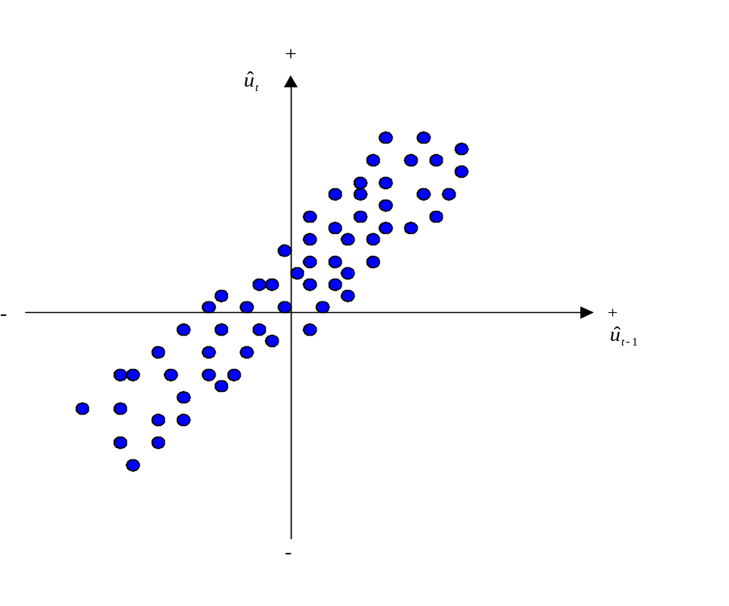
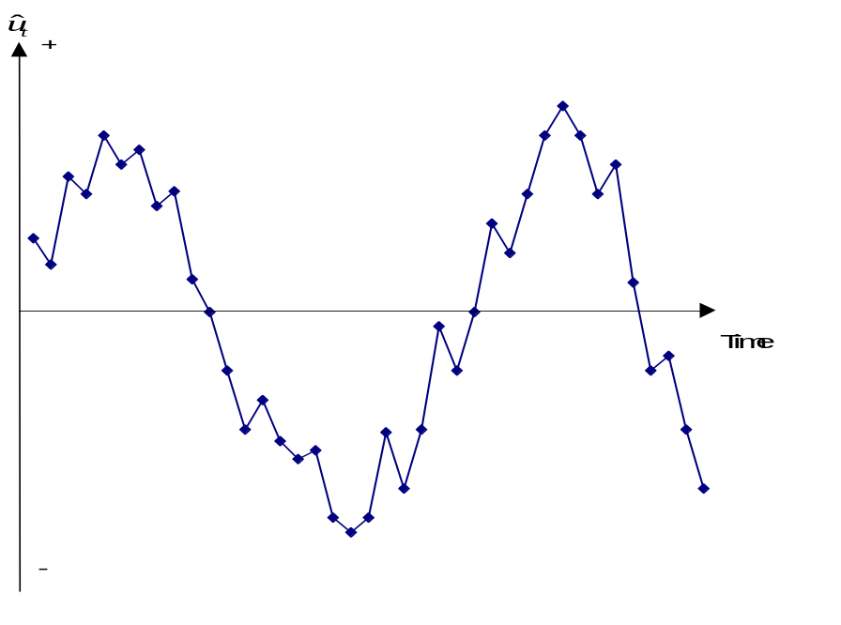
Positive Autocorrelation
Positive Autocorrelation is indicated by a cyclical residual plot over time.
‘Introductory Econometrics for Finance’ © Chris Brooks 2002

Slide 25
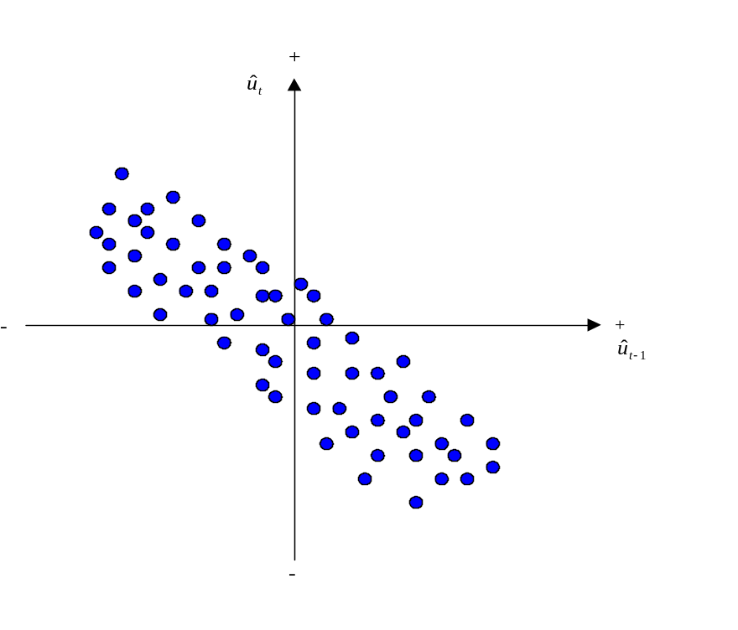
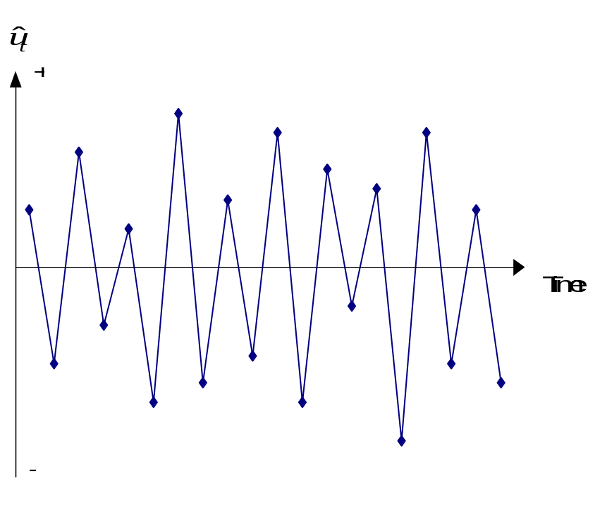
Negative Autocorrelation
Negative autocorrelation is indicated by an alternating pattern where the residuals
cross the time axis more frequently than if they were distributed randomly
‘Introductory Econometrics for Finance’ © Chris Brooks 2002

Slide 26
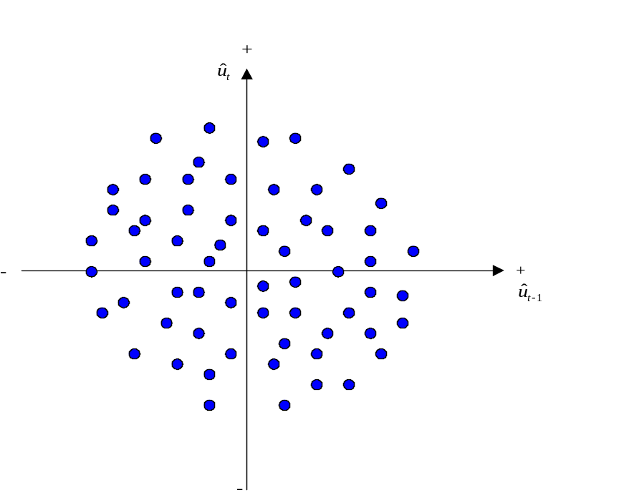
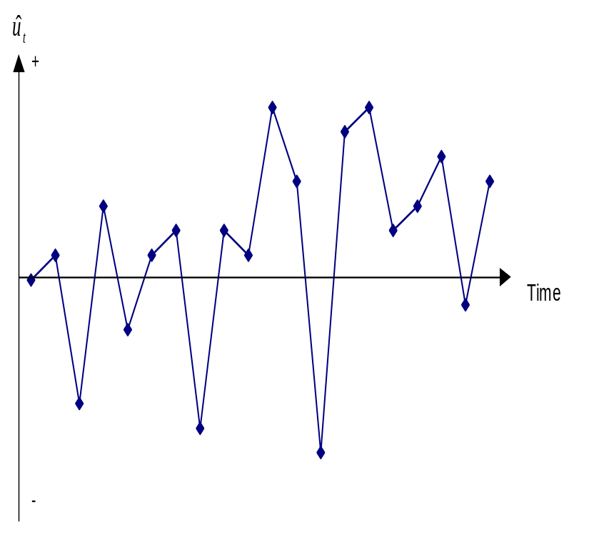
No pattern in residuals –
No autocorrelation
No pattern in residuals at all: this is what we would like to see
‘Introductory Econometrics for Finance’ © Chris Brooks 2002

Slide 27
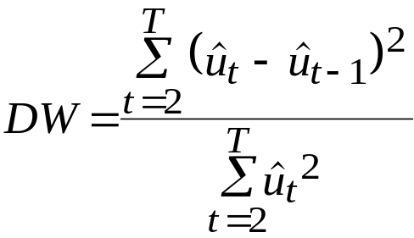
Detecting Autocorrelation:
The Durbin-Watson Test
The Durbin-Watson (DW) is a test for first order autocorrelation - i.e. it assumes that the relationship is between an error and the previous one
u_{t} = ρu_{t-1} + v_{t} (1)
where v_{t} ∼ N(0, σ_{v}²).
The DW test statistic actually tests
H₀ : ρ=0 and H₁ : ρ≠0
The test statistic is calculated by
‘Introductory Econometrics for Finance’ © Chris Brooks 2002

Slide 28



The Durbin-Watson Test:
Critical Values
We can also write
(2)
where is the estimated correlation coefficient. Since is a correlation, it implies that .
Rearranging for DW from (2) would give 0≤DW≤4.
If = 0, DW = 2. So roughly speaking, do not reject the null hypothesis if DW is near 2 → i.e. there is little evidence of autocorrelation
Unfortunately, DW has 2 critical values, an upper critical value (d_{u}) and a lower critical value (d_{L}), and there is also an intermediate region where we can neither reject nor not reject H₀.
‘Introductory Econometrics for Finance’ © Chris Brooks 2002

Slide 29
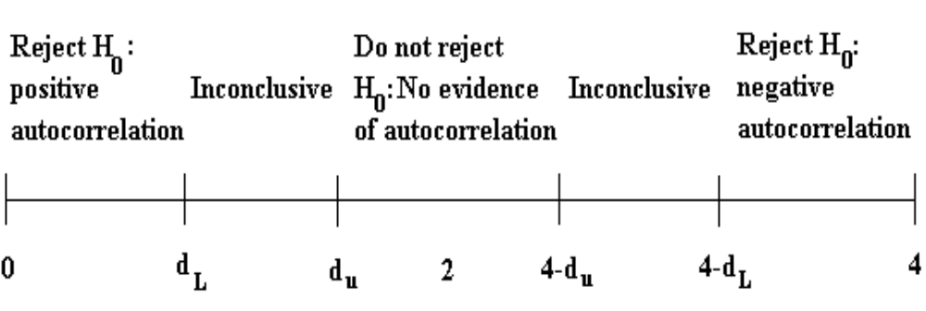
The Durbin-Watson Test: Interpreting the Results
Conditions which Must be Fulfilled for DW to be a Valid Test
1. Constant term in regression
2. Regressors are non-stochastic
3. No lags of dependent variable
‘Introductory Econometrics for Finance’ © Chris Brooks 2002

Slide 30



Another Test for Autocorrelation:
The Breusch-Godfrey Test
It is a more general test for r^{th} order autocorrelation:
∼N(0, )
The null and alternative hypotheses are:
H₀ : ρ₁ = 0 and ρ₂ = 0 and ... and ρ_{r} = 0
H₁ : ρ₁ ≠ 0 or ρ₂ ≠ 0 or ... or ρ_{r} ≠ 0
The test is carried out as follows:
1. Estimate the linear regression using OLS and obtain the residuals, .
2. Regress on all of the regressors from stage 1 (the x’s) plus
Obtain R² from this regression.
3. It can be shown that (T-r)R² ∼ χ²(r)
If the test statistic exceeds the critical value from the statistical tables, reject the null hypothesis of no autocorrelation.
‘Introductory Econometrics for Finance’ © Chris Brooks 2002

Slide 31
Consequences of Ignoring Autocorrelation if it is Present
The coefficient estimates derived using OLS are still unbiased, but they are inefficient, i.e. they are not BLUE, even in large sample sizes.
Thus, if the standard error estimates are inappropriate, there exists the possibility that we could make the wrong inferences.
R² is likely to be inflated relative to its “correct” value for positively correlated residuals.
‘Introductory Econometrics for Finance’ © Chris Brooks 2002

Slide 32
“Remedies” for Autocorrelation
If the form of the autocorrelation is known, we could use a GLS procedure – i.e. an approach that allows for autocorrelated residuals e.g., Cochrane-Orcutt.
But such procedures that “correct” for autocorrelation require assumptions about the form of the autocorrelation.
If these assumptions are invalid, the cure would be more dangerous than the disease! - see Hendry and Mizon (1978).
However, it is unlikely to be the case that the form of the autocorrelation is known, and a more “modern” view is that residual autocorrelation presents an opportunity to modify the regression.
‘Introductory Econometrics for Finance’ © Chris Brooks 2002

Slide 33
Dynamic Models
All of the models we have considered so far have been static, e.g.
y_{t} = β₁ + β₂x_{2t} + ... + β_{k}x_{kt} + u_{t}
But we can easily extend this analysis to the case where the current value of y_{t} depends on previous values of y or one of the x’s, e.g.
y_{t} = β₁ + β₂x_{2t} + ... + β_{k}x_{kt} + γ₁y_{t-1} + γ₂x_{2t-1} + … + γ_{k}x_{kt-1}+ u_{t}
We could extend the model even further by adding extra lags, e.g.
x_{2t-2} , y_{t-3} .
‘Introductory Econometrics for Finance’ © Chris Brooks 2002

Slide 34
Why Might we Want/Need To Include Lags in a Regression?
Inertia of the dependent variable
Over-reactions
Measuring time series as overlapping moving averages
However, other problems with the regression could cause the null hypothesis of no autocorrelation to be rejected:
  Omission of relevant variables, which are themselves autocorrelated.
  If we have committed a “misspecification” error by using an inappropriate functional form.
  Autocorrelation resulting from unparameterised seasonality.
‘Introductory Econometrics for Finance’ © Chris Brooks 2002

Slide 35
Models in First Difference Form
Another way to sometimes deal with the problem of autocorrelation is to switch to a model in first differences.
Denote the first difference of y_{t}, i.e. y_{t} - y_{t-1} as Δy_{t}; similarly for the x-variables, Δx_{2t} = x_{2t} - x_{2t-1} etc.
The model would now be
Δy_{t} = β₁ + β₂ Δx_{2t} + ... + β_{k}Δx_{kt} + u_{t}
Sometimes the change in y is purported to depend on previous values of y or x_{t} as well as changes in x:
Δy_{t} = β₁ + β₂ Δx_{2t} + β₃x_{2t-1} +β₄y_{t-1} + u_{t}
‘Introductory Econometrics for Finance’ © Chris Brooks 2002

Slide 36
The Long Run Static Equilibrium Solution
One interesting property of a dynamic model is its long run or static equilibrium solution.
“Equilibrium” implies that the variables have reached some steady state and are no longer changing, i.e. if y and x are in equilibrium, we can say
y_{t} = y_{t+1} = ... =y and x_{t} = x_{t+1} = ... =x
Consequently, Δy_{t} = y_{t} - y_{t-1} = y - y = 0 etc.
So the way to obtain a long run static solution is:
1. Remove all time subscripts from variables
2. Set error terms equal to their expected values, E(u_{t})=0
3. Remove first difference terms altogether
4. Gather terms in x together and gather terms in y together.
These steps can be undertaken in any order
‘Introductory Econometrics for Finance’ © Chris Brooks 2002

Slide 37
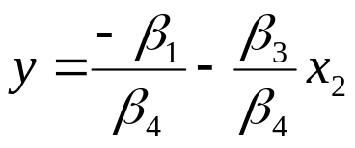
The Long Run Static Equilibrium Solution:
An Example
If our model is
Δy_{t} = β₁ + β₂ Δx_{2t} + β₃x_{2t-1} +β₄y_{t-1} + u_{t}
then the static solution would be given by
0 = β₁ + β₃x_{2t-1} +β₄y_{t-1}
β₄y_{t-1} = - β₁ - β₃x_{2t-1}
‘Introductory Econometrics for Finance’ © Chris Brooks 2002

Slide 38
Problems with Adding Lagged Regressors to “Cure” Autocorrelation
Inclusion of lagged values of the dependent variable violates the assumption that the RHS variables are non-stochastic.
What does an equation with a large number of lags actually mean?
Note that if there is still autocorrelation in the residuals of a model including lags, then the OLS estimators will not even be consistent.
‘Introductory Econometrics for Finance’ © Chris Brooks 2002

Slide 39
Multicollinearity
This problem occurs when the explanatory variables are very highly correlated with each other.
Perfect multicollinearity
Cannot estimate all the coefficients
- e.g. suppose x₃ = 2x₂
and the model is y_{t} = β₁ + β₂x_{2t} + β₃x_{3t} + β₄x_{4t} + u_{t}
Problems if Near Multicollinearity is Present but Ignored
- R² will be high but the individual coefficients will have high standard errors.
- The regression becomes very sensitive to small changes in the specification.
- Thus confidence intervals for the parameters will be very wide, and significance tests might therefore give inappropriate conclusions.
‘Introductory Econometrics for Finance’ © Chris Brooks 2002

Slide 40
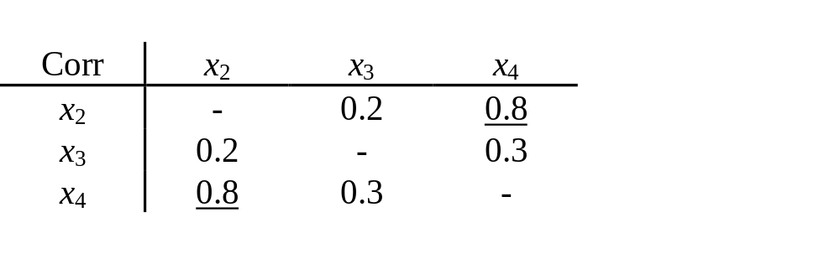
Measuring Multicollinearity
The easiest way to measure the extent of multicollinearity is simply to look at the matrix of correlations between the individual variables. e.g.
But another problem: if 3 or more variables are linear
- e.g. x_{2t} + x_{3t} = x_{4t}
Note that high correlation between y and one of the x’s is not muticollinearity.
‘Introductory Econometrics for Finance’ © Chris Brooks 2002

Slide 41
Solutions to the Problem of Multicollinearity
“Traditional” approaches, such as ridge regression or principal components. But these usually bring more problems than they solve.
Some econometricians argue that if the model is otherwise OK, just ignore it
The easiest ways to “cure” the problems are
- drop one of the collinear variables
- transform the highly correlated variables into a ratio
- go out and collect more data e.g.
- a longer run of data
- switch to a higher frequency
‘Introductory Econometrics for Finance’ © Chris Brooks 2002

Slide 42




Adopting the Wrong Functional Form
We have previously assumed that the appropriate functional form is linear.
This may not always be true.
We can formally test this using Ramsey’s RESET test, which is a general test for mis-specification of functional form.
Essentially the method works by adding higher order terms of the fitted values (e.g. etc.) into an auxiliary regression:
Regress on powers of the fitted values:
Obtain R² from this regression. The test statistic is given by TR² and is distributed as a .
So if the value of the test statistic is greater than a then reject the null hypothesis that the functional form was correct.
‘Introductory Econometrics for Finance’ © Chris Brooks 2002

Slide 43


But what do we do if this is the case?
The RESET test gives us no guide as to what a better specification might be.
One possible cause of rejection of the test is if the true model is
In this case the remedy is obvious.
Another possibility is to transform the data into logarithms. This will linearise many previously multiplicative models into additive ones:
‘Introductory Econometrics for Finance’ © Chris Brooks 2002

Slide 44
Testing the Normality Assumption
Why did we need to assume normality for hypothesis testing?
Testing for Departures from Normality
The Bera Jarque normality test
A normal distribution is not skewed and is defined to have a coefficient of kurtosis of 3.
The kurtosis of the normal distribution is 3 so its excess kurtosis (b₂-3) is zero.
Skewness and kurtosis are the (standardised) third and fourth moments of a distribution.
‘Introductory Econometrics for Finance’ © Chris Brooks 2002

Slide 45
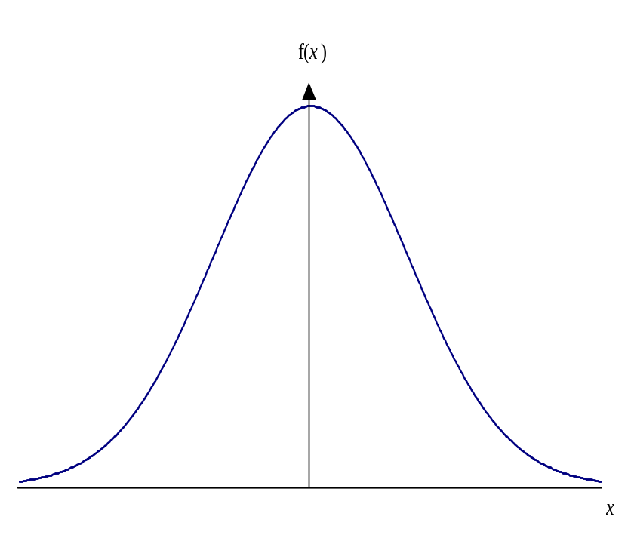
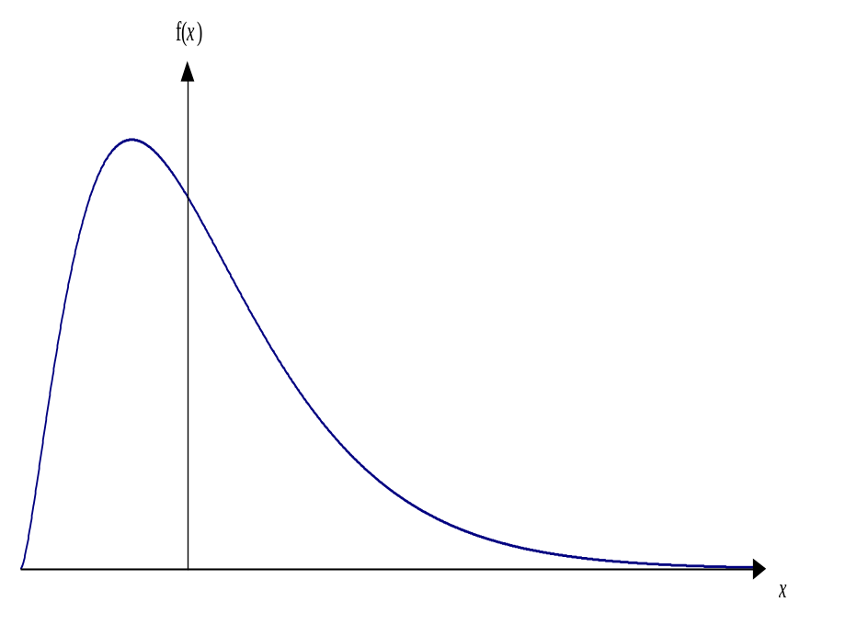
Normal versus Skewed Distributions
A normal distribution A skewed distribution
‘Introductory Econometrics for Finance’ © Chris Brooks 2002

Slide 46
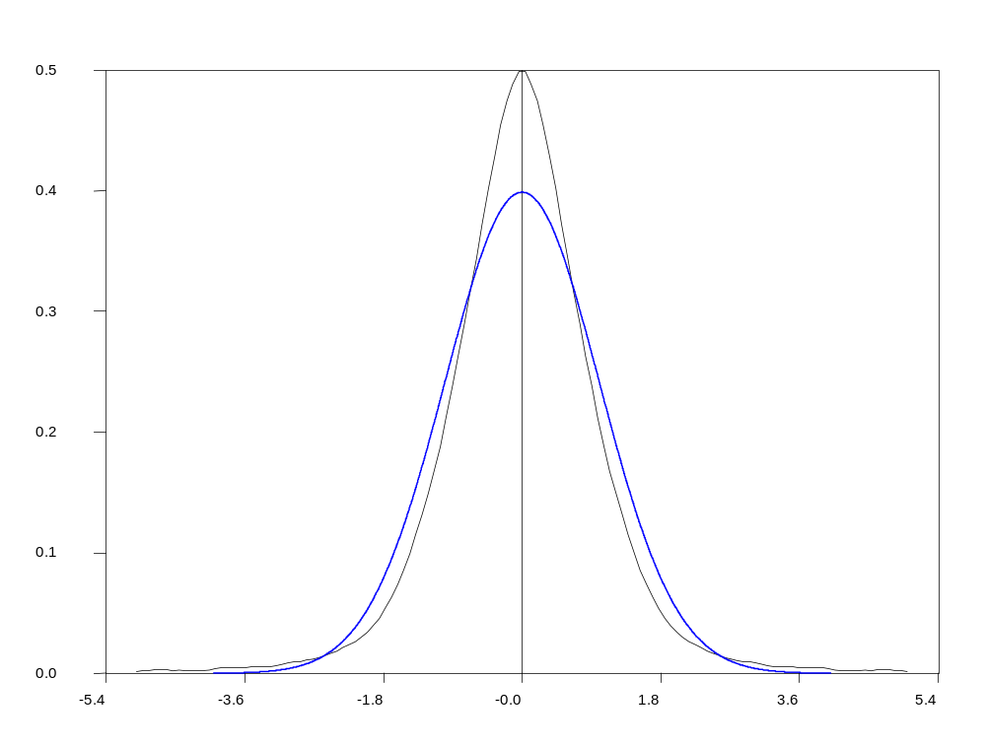
Leptokurtic versus Normal Distribution
‘Introductory Econometrics for Finance’ © Chris Brooks 2002

Slide 47
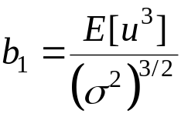
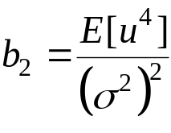
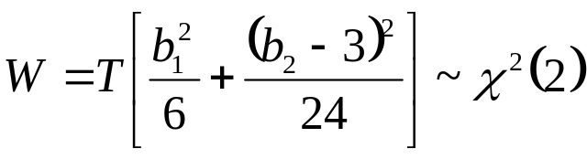
Testing for Normality
Bera and Jarque formalise this by testing the residuals for normality by testing whether the coefficient of skewness and the coefficient of excess kurtosis are jointly zero.
It can be proved that the coefficients of skewness and kurtosis can be expressed respectively as:
and
The Bera Jarque test statistic is given by
We estimate b₁ and b₂ using the residuals from the OLS regression, .
‘Introductory Econometrics for Finance’ © Chris Brooks 2002

Slide 48
What do we do if we find evidence of Non-Normality?
It is not obvious what we should do!
Could use a method which does not assume normality, but difficult and what are its properties?
Often the case that one or two very extreme residuals causes us to reject the normality assumption.
An alternative is to use dummy variables.
e.g. say we estimate a monthly model of asset returns from 1980-1990, and we plot the residuals, and find a particularly large outlier for October 1987:
‘Introductory Econometrics for Finance’ © Chris Brooks 2002

Slide 49
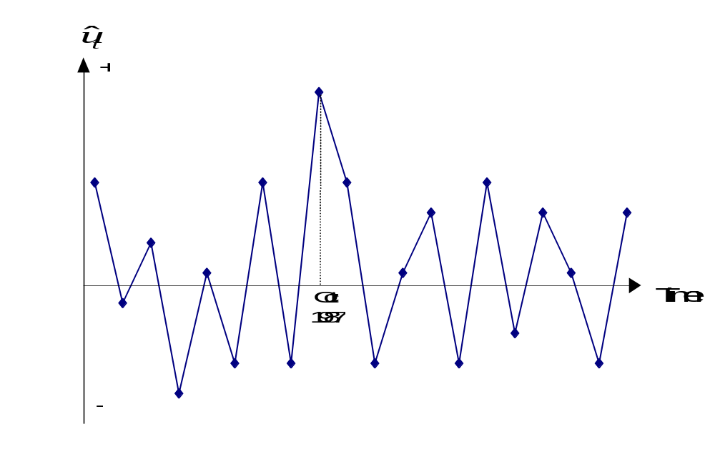
What do we do if we find evidence of Non-Normality? (cont’d)
Create a new variable:
D87M10_{t} = 1 during October 1987 and zero otherwise.
This effectively knocks out that observation. But we need a theoretical reason for adding dummy variables.
‘Introductory Econometrics for Finance’ © Chris Brooks 2002

Slide 50
Omission of an Important Variable or
Inclusion of an Irrelevant Variable
Omission of an Important Variable
Consequence: The estimated coefficients on all the other variables will be biased and inconsistent unless the excluded variable is uncorrelated with all the included variables.
Even if this condition is satisfied, the estimate of the coefficient on the constant term will be biased.
The standard errors will also be biased.
Inclusion of an Irrelevant Variable
Coefficient estimates will still be consistent and unbiased, but the estimators will be inefficient.
‘Introductory Econometrics for Finance’ © Chris Brooks 2002

Slide 51
Parameter Stability Tests
So far, we have estimated regressions such as
We have implicitly assumed that the parameters (β₁, β₂ and β₃) are constant for the entire sample period.
We can test this implicit assumption using parameter stability tests. The idea is essentially to split the data into sub-periods and then to estimate up to three models, for each of the sub-parts and for all the data and then to “compare” the RSS of the models.
There are two types of test we can look at:
- Chow test (analysis of variance test)
- Predictive failure tests
‘Introductory Econometrics for Finance’ © Chris Brooks 2002

Slide 52
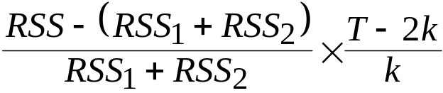
The Chow Test
The steps involved are:
1. Split the data into two sub-periods. Estimate the regression over the whole period and then for the two sub-periods separately (3 regressions). Obtain the RSS for each regression.
2. The restricted regression is now the regression for the whole period while the “unrestricted regression” comes in two parts: for each of the sub-samples.
We can thus form an F-test which is the difference between the RSS’s.
The statistic is
‘Introductory Econometrics for Finance’ © Chris Brooks 2002

Slide 53
The Chow Test (cont’d)
where:
RSS = RSS for whole sample
RSS₁ = RSS for sub-sample 1
RSS₂ = RSS for sub-sample 2
T = number of observations
2k = number of regressors in the “unrestricted” regression (since it comes in two parts)
k = number of regressors in (each part of the) “unrestricted” regression
3. Perform the test. If the value of the test statistic is greater than the critical value from the F-distribution, which is an F(k, T-2k), then reject the null hypothesis that the parameters are stable over time.
‘Introductory Econometrics for Finance’ © Chris Brooks 2002

Slide 54
A Chow Test Example
Consider the following regression for the CAPM β (again) for the returns on Glaxo.
Say that we are interested in estimating Beta for monthly data from 1981-1992. The model for each sub-period is
1981M1 - 1987M10
0.24 + 1.2R_{Mt} T = 82 RSS₁ = 0.03555
1987M11 - 1992M12
0.68 + 1.53R_{Mt} T = 62 RSS₂ = 0.00336
1981M1 - 1992M12
0.39 + 1.37R_{Mt} T = 144 RSS = 0.0434
‘Introductory Econometrics for Finance’ © Chris Brooks 2002

Slide 55

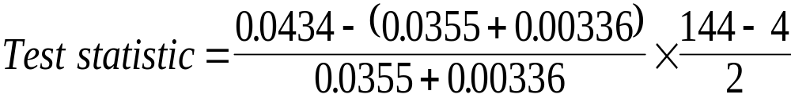
A Chow Test Example - Results
The null hypothesis is
The unrestricted model is the model where this restriction is not imposed
= 7.698
Compare with 5% F(2,140) = 3.06
We reject H₀ at the 5% level and say that we reject the restriction that the coefficients are the same in the two periods.
‘Introductory Econometrics for Finance’ © Chris Brooks 2002

Slide 56
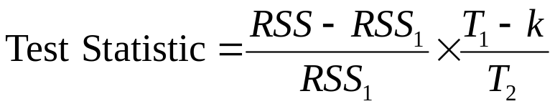
The Predictive Failure Test
Problem with the Chow test is that we need to have enough data to do the
regression on both sub-samples, i.e. T₁>>k, T₂>>k.
An alternative formulation is the predictive failure test.
What we do with the predictive failure test is estimate the regression over a “long” sub-period (i.e. most of the data) and then we predict values for the other period and compare the two.
To calculate the test:
- Run the regression for the whole period (the restricted regression) and obtain the RSS
- Run the regression for the “large” sub-period and obtain the RSS (called RSS₁). Note
we call the number of observations T₁ (even though it may come second).
where T₂ = number of observations we are attempting to “predict”. The test statistic
will follow an F(T₂, T₁-k).
‘Introductory Econometrics for Finance’ © Chris Brooks 2002

Slide 57
Backwards versus Forwards Predictive Failure Tests
There are 2 types of predictive failure tests:
- Forward predictive failure tests, where we keep the last few observations back for forecast testing, e.g. we have observations for 1970Q1-1994Q4. So estimate the model over 1970Q1-1993Q4 and forecast 1994Q1-1994Q4.
- Backward predictive failure tests, where we attempt to “back-cast” the first few observations, e.g. if we have data for 1970Q1-1994Q4, and we estimate the model over 1971Q1-1994Q4 and backcast 1970Q1-1970Q4.
‘Introductory Econometrics for Finance’ © Chris Brooks 2002

Slide 58
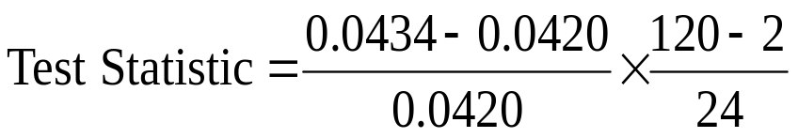
Predictive Failure Tests – An Example
We have the following models estimated:
For the CAPM β on Glaxo(!).
1980M1-1991M12
0.39 + 1.37R_{Mt} T = 144 RSS = 0.0434
1980M1-1989M12
0.32 + 1.31R_{Mt} T₁ = 120 RSS₁ = 0.0420
Can this regression adequately “forecast” the values for the last two years?
= 0.164
Compare with F(24,118) = 1.66.
So we do not reject the null hypothesis that the model can adequately predict the last few observations.
‘Introductory Econometrics for Finance’ © Chris Brooks 2002

Slide 59
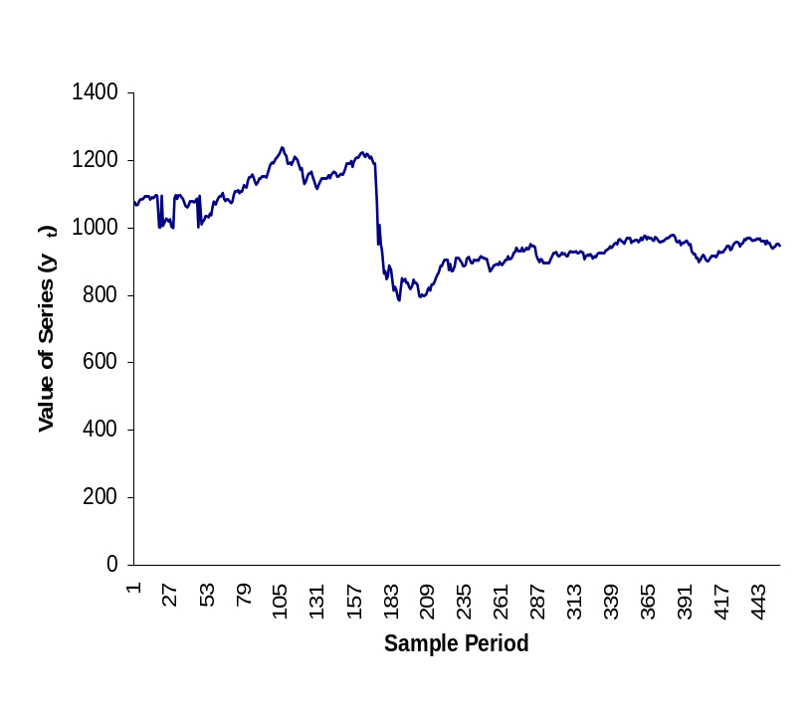
How do we decide the sub-parts to use?
As a rule of thumb, we could use all or some of the following:
- Plot the dependent variable over time and split the data accordingly to any
obvious structural changes in the series, e.g.
- Split the data according to any known important
historical events (e.g. stock market crash, new government elected)
- Use all but the last few observations and do a predictive failure test on those.
‘Introductory Econometrics for Finance’ © Chris Brooks 2002

Slide 60
A Strategy for Building Econometric Models
Our Objective:
To build a statistically adequate empirical model which
- satisfies the assumptions of the CLRM
- is parsimonious
- has the appropriate theoretical interpretation
- has the right “shape” - i.e.
- all signs on coefficients are “correct”
- all sizes of coefficients are “correct”
- is capable of explaining the results of all competing models
‘Introductory Econometrics for Finance’ © Chris Brooks 2002

Slide 61
2 Approaches to Building Econometric Models
There are 2 popular philosophies of building econometric models: the “specific-to-general” and “general-to-specific” approaches.
“Specific-to-general” was used almost universally until the mid 1980’s, and involved starting with the simplest model and gradually adding to it.
Little, if any, diagnostic testing was undertaken. But this meant that all inferences were potentially invalid.
An alternative and more modern approach to model building is the “LSE” or Hendry “general-to-specific” methodology.
The advantages of this approach are that it is statistically sensible and also the theory on which the models are based usually has nothing to say about the lag structure of a model.
‘Introductory Econometrics for Finance’ © Chris Brooks 2002

Slide 62
The General-to-Specific Approach
First step is to form a “large” model with lots of variables on the right hand side
This is known as a GUM (generalised unrestricted model)
At this stage, we want to make sure that the model satisfies all of the assumptions of the CLRM
If the assumptions are violated, we need to take appropriate actions to remedy this, e.g.
- taking logs
- adding lags
- dummy variables
We need to do this before testing hypotheses
Once we have a model which satisfies the assumptions, it could be very big with lots of lags & independent variables
‘Introductory Econometrics for Finance’ © Chris Brooks 2002

Slide 63
The General-to-Specific Approach:
Reparameterising the Model
The next stage is to reparameterise the model by
- knocking out very insignificant regressors
- some coefficients may be insignificantly different from each other,
so we can combine them.
At each stage, we need to check the assumptions are still OK.
Hopefully at this stage, we have a statistically adequate empirical model which we can use for
- testing underlying financial theories
- forecasting future values of the dependent variable
- formulating policies, etc.
‘Introductory Econometrics for Finance’ © Chris Brooks 2002

Slide 64
Regression Analysis In Practice - A Further Example:
Determinants of Sovereign Credit Ratings
Cantor and Packer (1996)
Financial background:
What are sovereign credit ratings and why are we interested in them?
Two ratings agencies (Moody’s and Standard and Poor’s) provide credit ratings for many governments.
Each possible rating is denoted by a grading:
  Moody’s Standard and Poor’s
  Aaa AAA
  …… …..
  B3 B-
‘Introductory Econometrics for Finance’ © Chris Brooks 2002

Slide 65
Purposes of the Paper
- to attempt to explain and model how the ratings agencies arrived at
their ratings.
- to use the same factors to explain the spreads of sovereign yields
above a risk-free proxy
- to determine what factors affect how the sovereign yields react to
ratings announcements
‘Introductory Econometrics for Finance’ © Chris Brooks 2002

Slide 66
Determinants of Sovereign Ratings
Data
Quantifying the ratings (dependent variable): Aaa/AAA=16, ... , B3/B-=1
Explanatory variables (units of measurement):
- Per capita income in 1994 (thousands of dollars)
- Average annual GDP growth 1991-1994 (%)
- Average annual inflation 1992-1994 (%)
- Fiscal balance: Average annual government budget surplus as a
proportion of GDP 1992-1994 (%)
- External balance: Average annual current account surplus as a proportion
of GDP 1992-1994 (%)
- External debt Foreign currency debt as a proportion of exports 1994 (%)
- Dummy for economic development
- Dummy for default history
Income and inflation are transformed to their logarithms.
‘Introductory Econometrics for Finance’ © Chris Brooks 2002

Slide 67
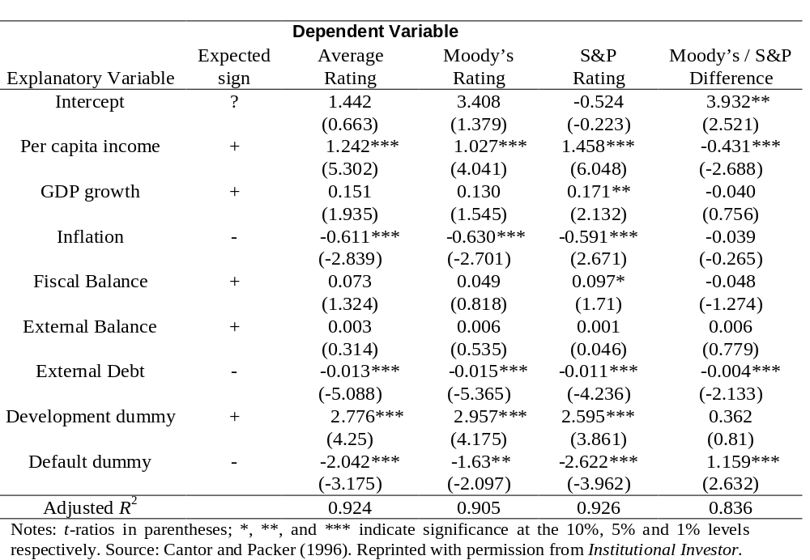
The model: Linear and estimated using OLS
‘Introductory Econometrics for Finance’ © Chris Brooks 2002

Slide 68
Interpreting the Model
From a statistical perspective
Virtually no diagnostics
Adjusted R² is high
Look at the residuals: actual rating - fitted rating
From a financial perspective
Do the coefficients have their expected signs and sizes?
Do Ratings Add to Publicly Available Available Information?
Now dependent variable is
- Log (Yield on the sovereign bond - yield on a US treasury bond)
‘Introductory Econometrics for Finance’ © Chris Brooks 2002

Slide 69
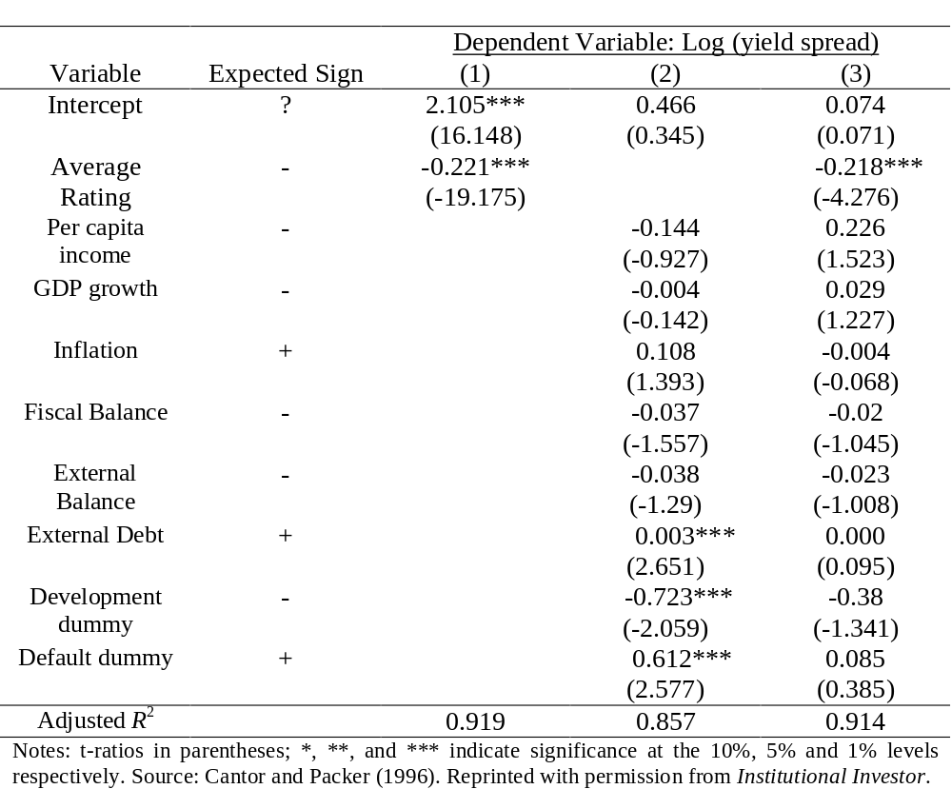
Do Ratings Add to Publicly Available Available Information? Results
‘Introductory Econometrics for Finance’ © Chris Brooks 2002

Slide 70
What Determines How the Market Reacts to Ratings Announcements?
The sample: Every announcement of a ratings change that occurred between 1987 and 1994 - 79 such announcements spread over 18 countries.
39 were actual ratings changes
40 were “watchlist / outlook” changes
The dependent variable: changes in the relative spreads over the US T-bond over a 2-day period at the time of the announcement.
‘Introductory Econometrics for Finance’ © Chris Brooks 2002

Slide 71
What Determines How the Market Reacts to Ratings Announcements? Explanatory variables.
0 /1 dummies for
- Whether the announcement was positive
- Whether there was an actual ratings change
- Whether the bond was speculative grade
- Whether there had been another ratings announcement in the previous 60 days.
and
- The change in the spread over the previous 60 days.
- The ratings gap between the announcing and the other agency
‘Introductory Econometrics for Finance’ © Chris Brooks 2002

Slide 72
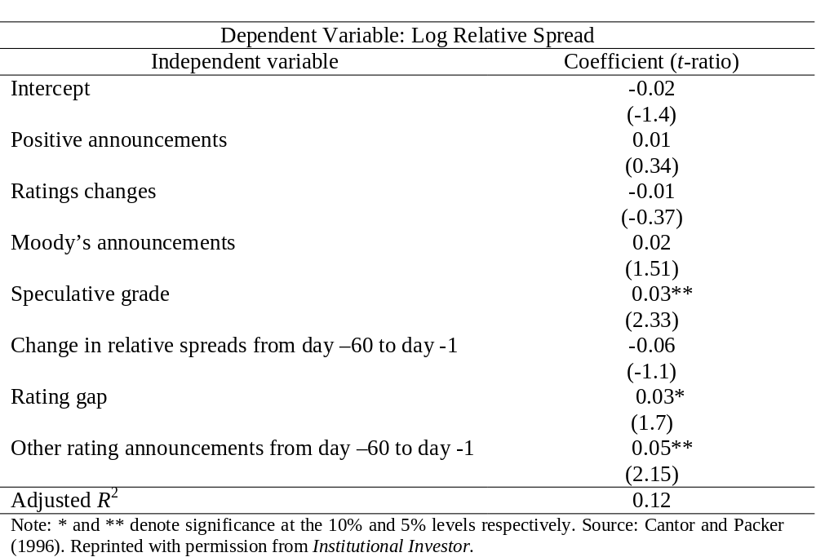
What Determines How the Market Reacts to Ratings Announcements? Results
‘Introductory Econometrics for Finance’ © Chris Brooks 2002

Slide 73
Conclusions
6 factors appear to play a big role in determining sovereign credit ratings - incomes, GDP growth, inflation, external debt, industrialised or not, and default history.
The ratings provide more information on yields than all of the macro factors put together.
We cannot determine well what factors influence how the markets will react to ratings announcements.
‘Introductory Econometrics for Finance’ © Chris Brooks 2002

Slide 74
Comments on the Paper
Only 49 observations for first set of regressions and 35 for yield regressions and up to 10 regressors
No attempt at reparameterisation
Little attempt at diagnostic checking
Where did the factors (explanatory variables) come from?
‘Introductory Econometrics for Finance’ © Chris Brooks 2002

